Slide 1


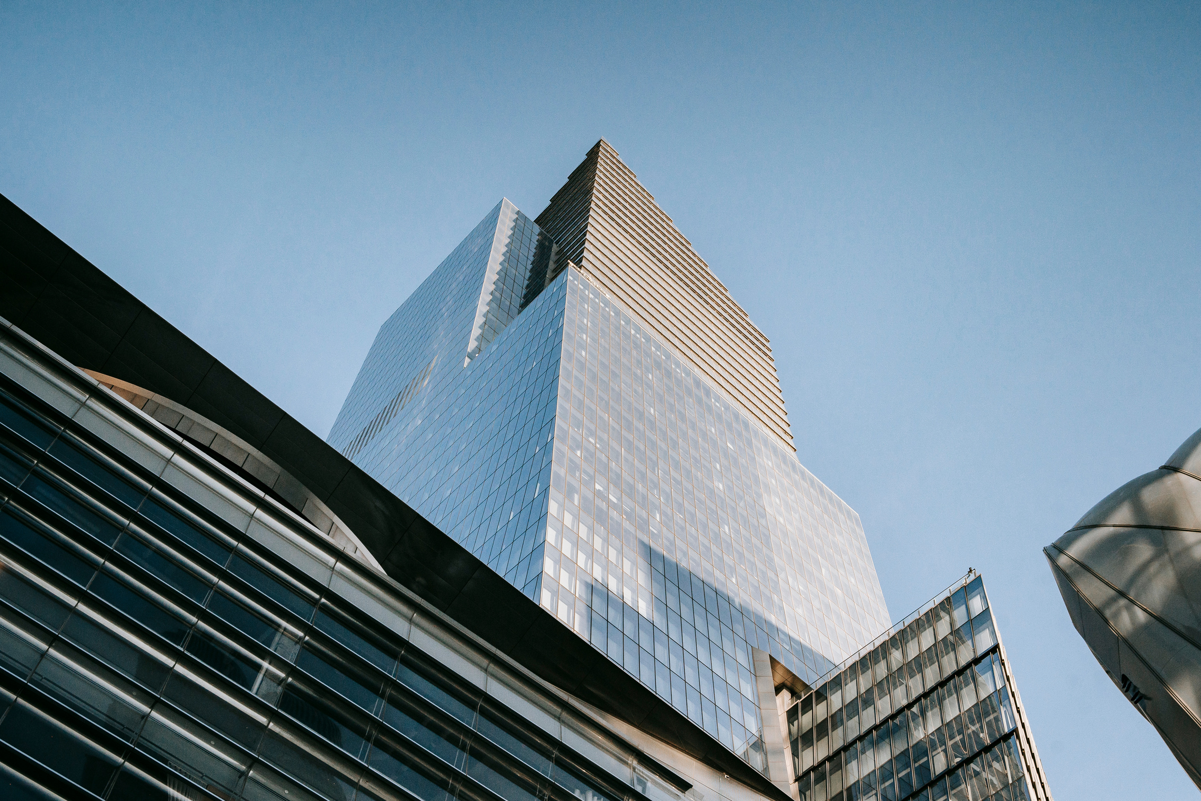
TUMORTRACE:
MRI-BASED AI FOR BREAST CANCER DETECTION
Presented by: Ayush Vyas

Slide 2
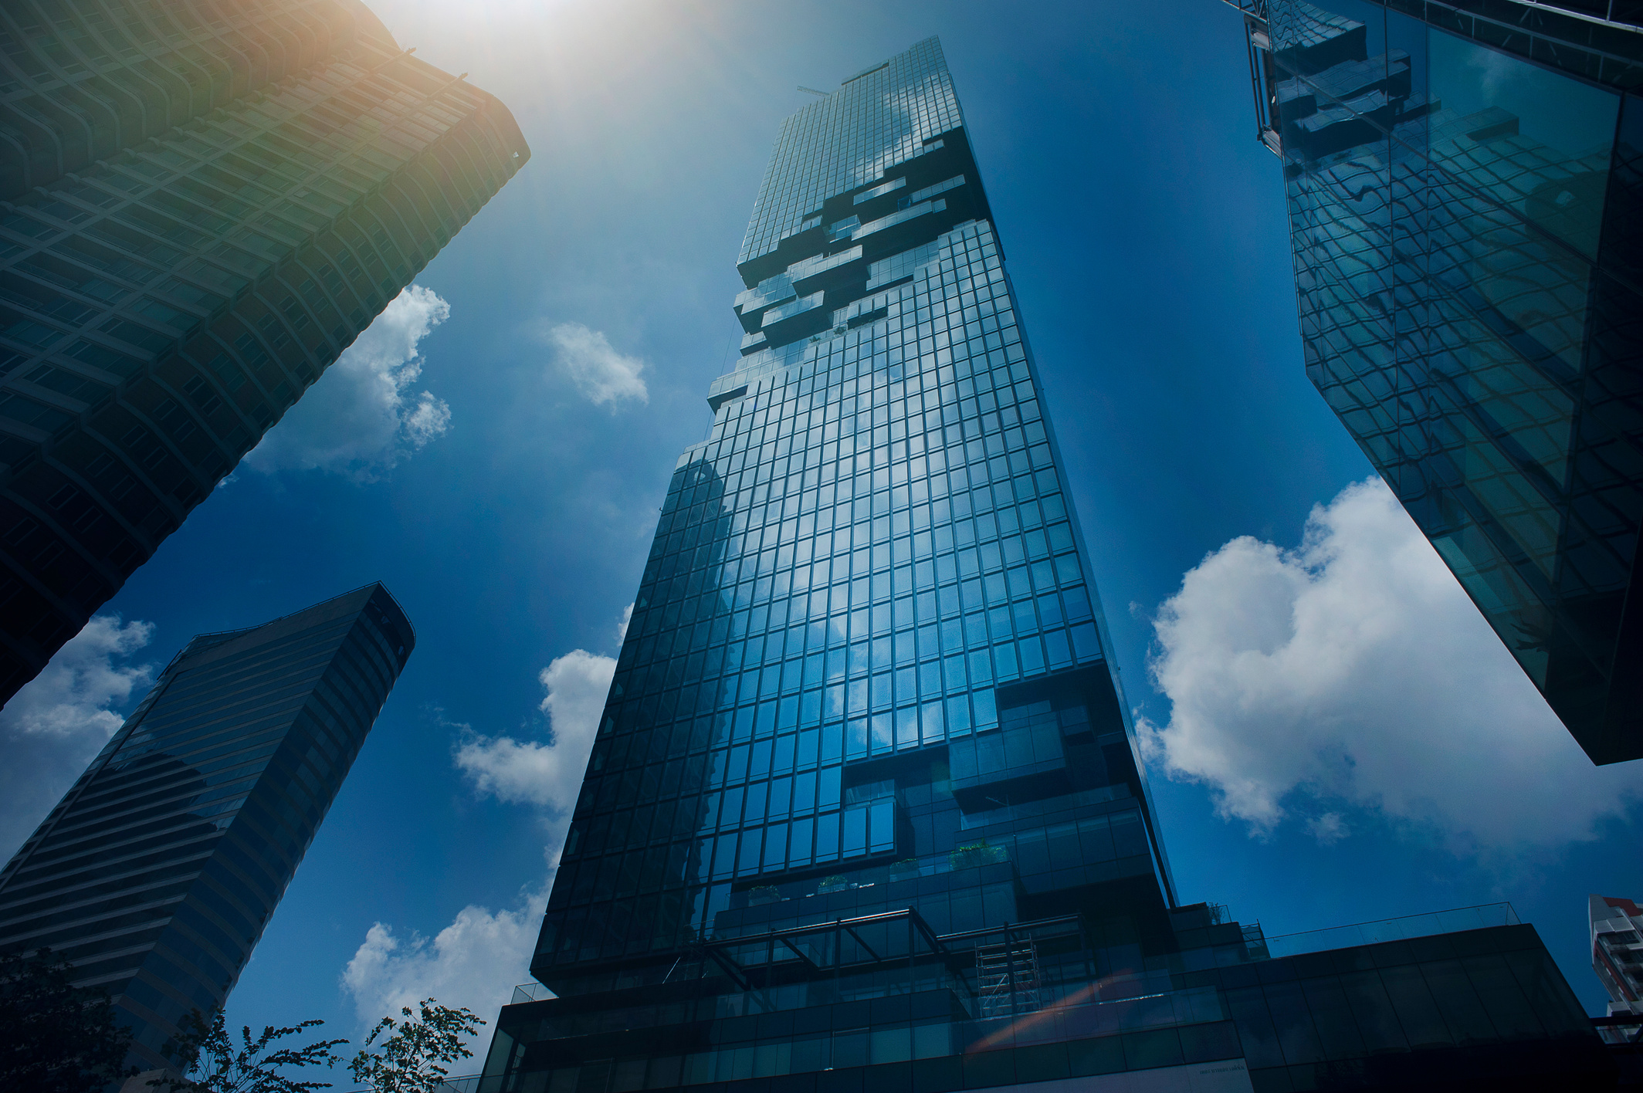
01
02
03
Problem
Data Collection and PreProcessing
Methods
OVERVIEW
04
05
06
Model and training
Results
Demo recoding
07
Ending

Slide 3
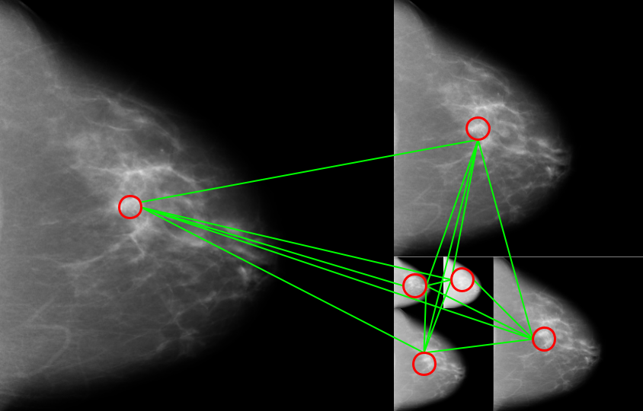

PROBLEM
BACKGROUND:
Breast cancer is a critical global health challenge
Early detection significantly improves patient survival rates
KEY CHALLENGES:
Accurate differentiation between benign and malignant tumors
High dependency on radiologist's interpretation
Potential for human error in medical image analysis
RESEARCH OBJECTIVE:
Develop machine learning models for automated MRI tumor classification
Improve diagnostic accuracy and early detection rates
Reduce variability in tumor identification
SIGNIFICANCE
Potentially save lives through earlier and more precise detection
Provide a supportive tool for medical professionals
Leverage advanced machine learning techniques in medical diagnostics

Slide 4
DATA COLLECTION AND PREPROCESSING
Dataset :
Content: MRI images labeled as either benign or malignant.
Source of Dataset:https://www.sciencedirect.com/science/article/abs/pii/S0010482523007205
Preprocessing Steps :
Grayscale Conversion: Convert images to grayscale format.
Resizing: Resize images to standard dimensions (e.g., 224x224).
Normalization: Normalize pixel values for compatibility with neural network inputs.
Augmentation: Apply data augmentation techniques (e.g., rotation, flipping).
Handling Class Imbalance: Use techniques like oversampling, undersampling, or applying class weights.

Slide 5
03
MODELS USED AND DEVELOPMENT
Models
VGG16: A convolutional neural network with 16 layers, chosen for simplicity and effectiveness in image classification.
ResNet18 & ResNet50: Deeper architectures using residual connections for improved performance.
Development Steps
Initialize pre-trained models.
Fine-tune models on the breast cancer dataset.
Train and validate models.
Evaluation Metrics
Accuracy: Measures percentage of correct predictions.
Precision: Evaluates the model’s ability to avoid false positives.
Recall (Sensitivity): Assesses the model’s ability to identify actual positive cases.
F1 Score: Harmonic mean of precision and recall.
AUC (Area Under Curve): Indicates how well the model distinguishes between benign and malignant tumors.
Confusion Matrix: Provides counts of true positives, true negatives, false positives, and false negatives.

Slide 6
PROJECT
CONCEPT
Accuracy: Percentage of correct predictions.
Precision: Ability of the model to avoid false positives.
Recall: Ability of the model to identify actual positive cases (sensitivity).
F1 Score: Harmonic mean of precision and recall.
AUC (Area Under Curve): Measures how well the model distinguishes between benign and malignant tumors.
Confusion Matrix: Table that helps you understand the performance of your classification. It shows the counts of true positives. true negatives, false positives, and Ifyspringboant.onwingg issharing Stop sharing Taist Titgalives.

Slide 7
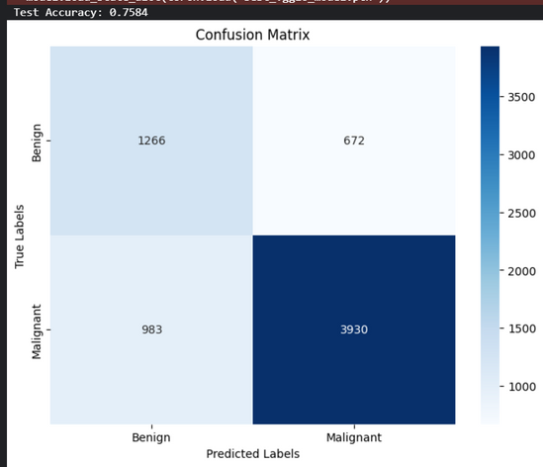
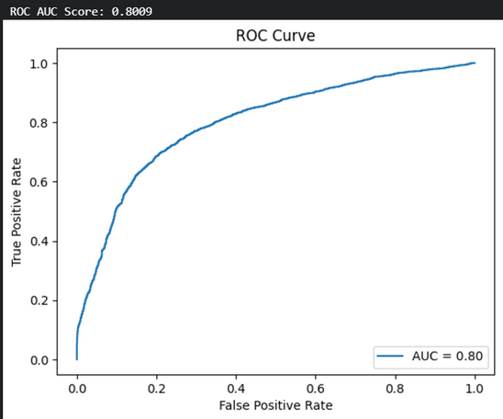
RESULTS : VGG16
Classification Report of Test
Precision recall f1-score support
BENIGN
MALIGNANT
ACCURACY
MACRO AVG
WEIGHTED AVG
0.7061
0.8213
0.7637
0.7887
0.4933
0.9189
0.7061
0.7985
0.5808
0.8674
0.7985
0.7241
0.7863
1938
4910
6848
6848
6848
Specificity : 1.0000,Sensitivity : 0.00000 ,AUC : 0.8663
test set: Average loss : 0.9104 ,Accuracy :5496/6851 (80.09%)

Slide 8
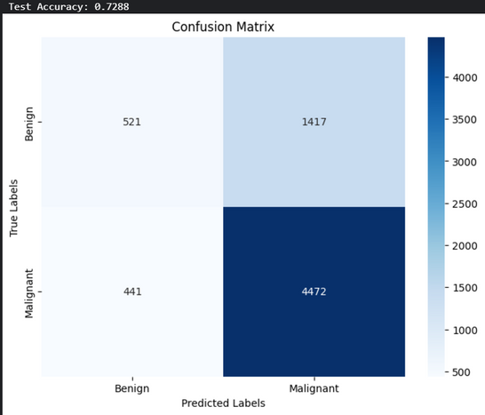
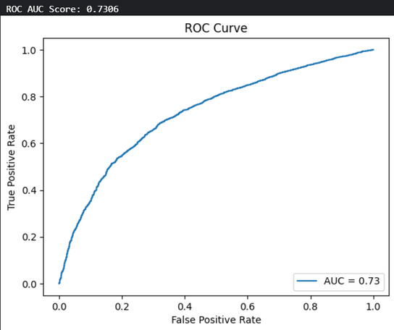
RESULTS : VGG16
Classification Report of Test
Precision recall f1-score support
BENIGN
MALIGNANT
ACCURACY
MACRO AVG
WEIGHTED AVG
0.7061
0.8213
0.7637
0.7887
0.4933
0.9189
0.7061
0.7985
0.5808
0.8674
0.7985
0.7241
0.7863
1938
4910
6848
6848
6848
Specificity : 1.0000,Sensitivity : 0.00000 ,AUC : 0.7306
test set: Average loss : 0.9104 ,Accuracy :5516/6851 (72.88%)

Slide 9
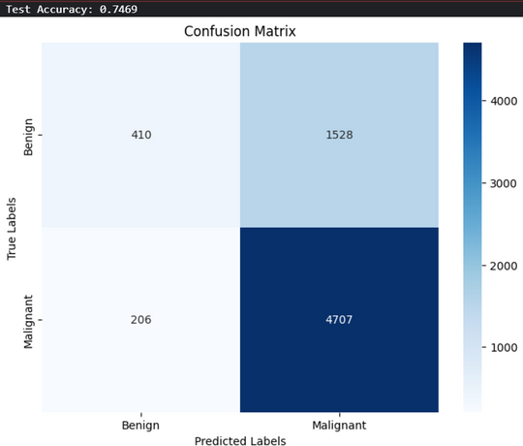
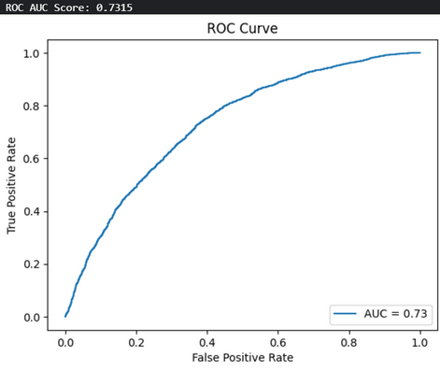
RESULTS :RESNET18
Classification Report of Test
Precision recall f1-score support
BENIGN
MALIGNANT
ACCURACY
MACRO AVG
WEIGHTED AVG
0.7061
0.8213
0.7637
0.7887
0.4933
0.9189
0.7061
0.7985
0.5808
0.8674
0.7985
0.7241
0.7863
1938
4910
6848
6848
6848
Specificity : 1.0000,Sensitivity : 0.00000 ,AUC : 0.7315
test set: Average loss : 0.9104 ,Accuracy :5496/6851 (74.69%)

Slide 10
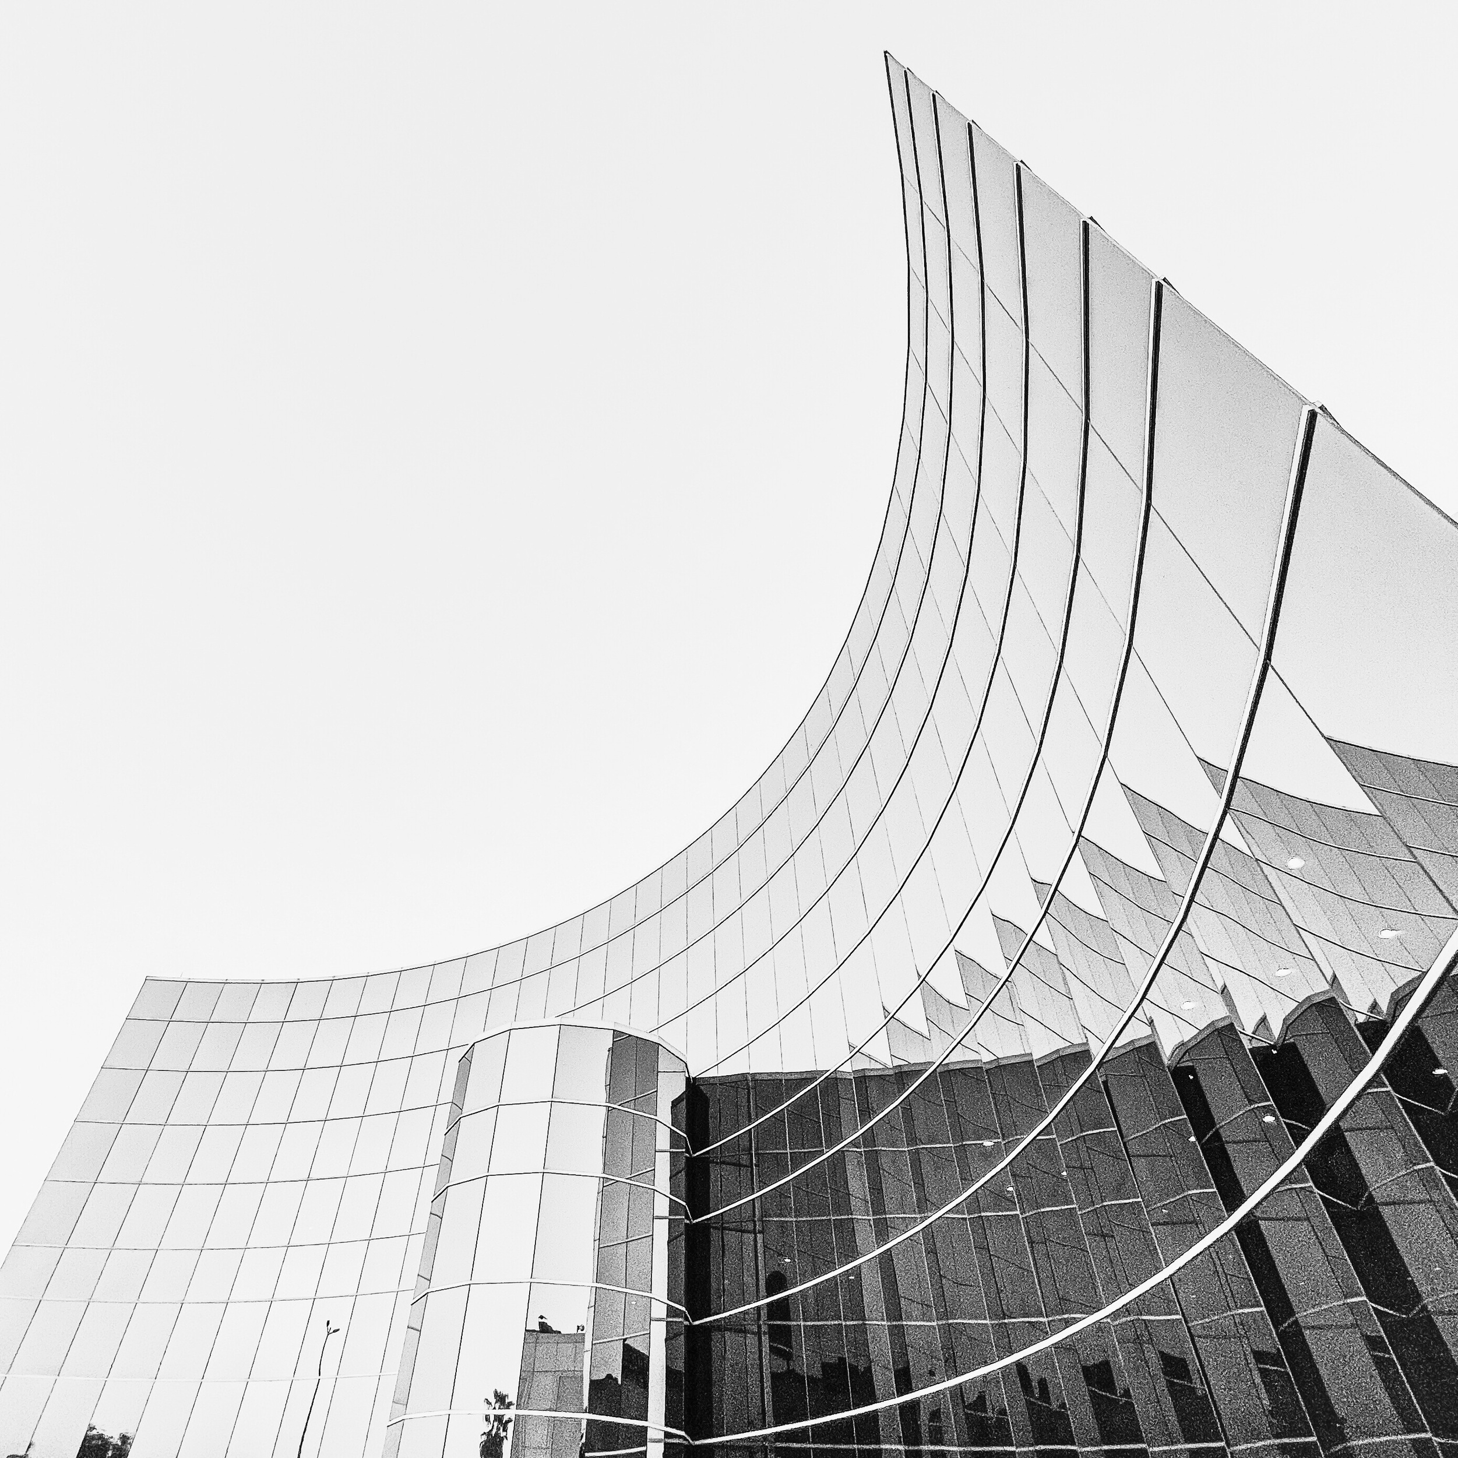
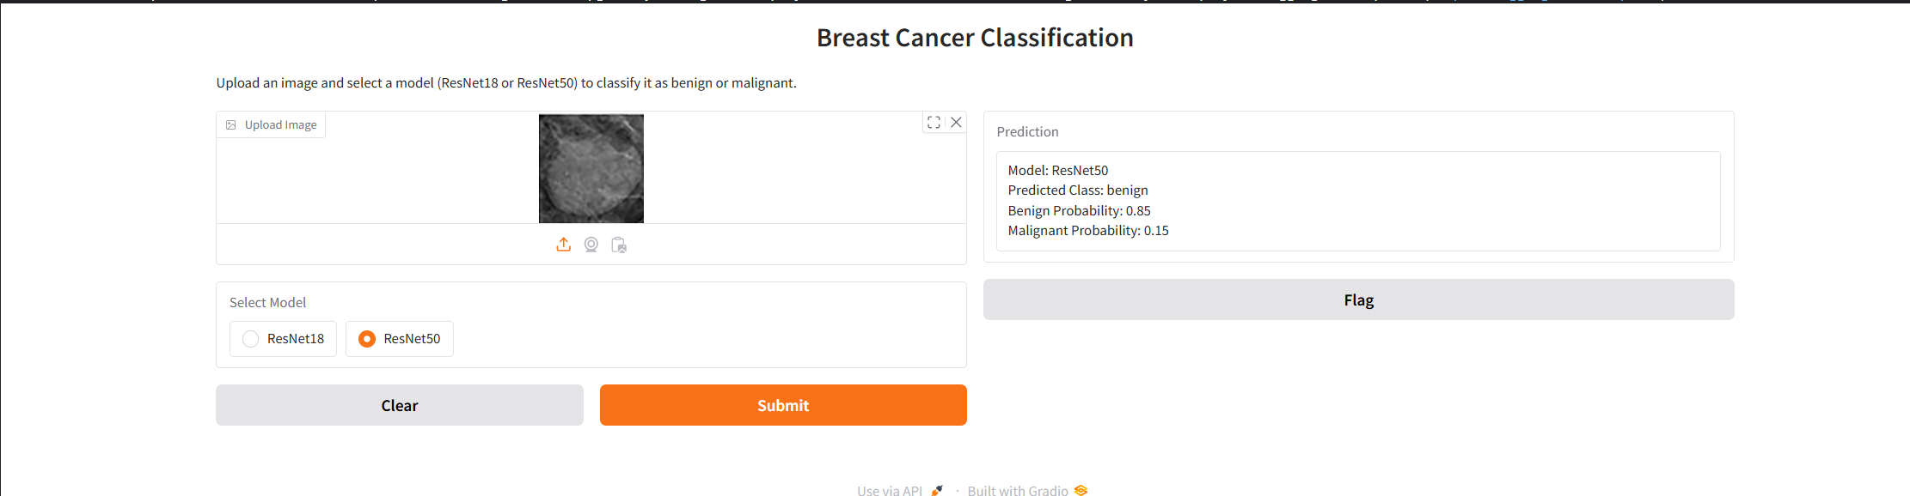
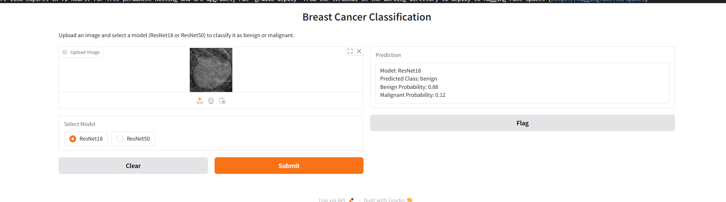
FINAL RESULTS

Slide 11
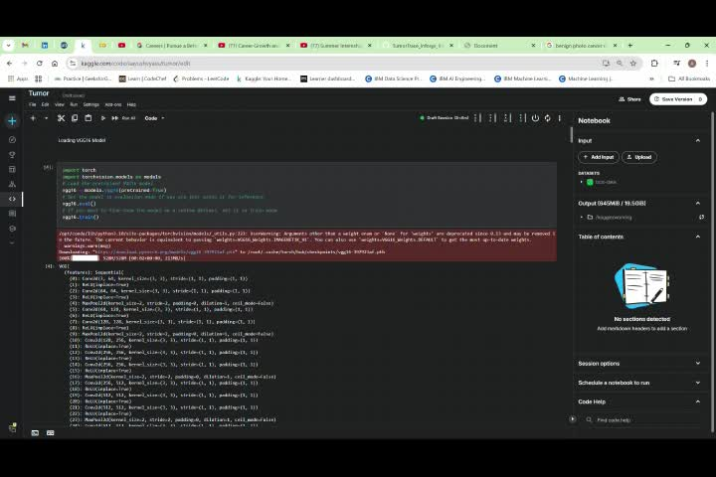
Video Presentation
https://drive.google.com/file/d/1yZcJJELpZbkHbC-p-ohCo297NL0SuU7b/view

Slide 12

THANK YOU

